Slide 1

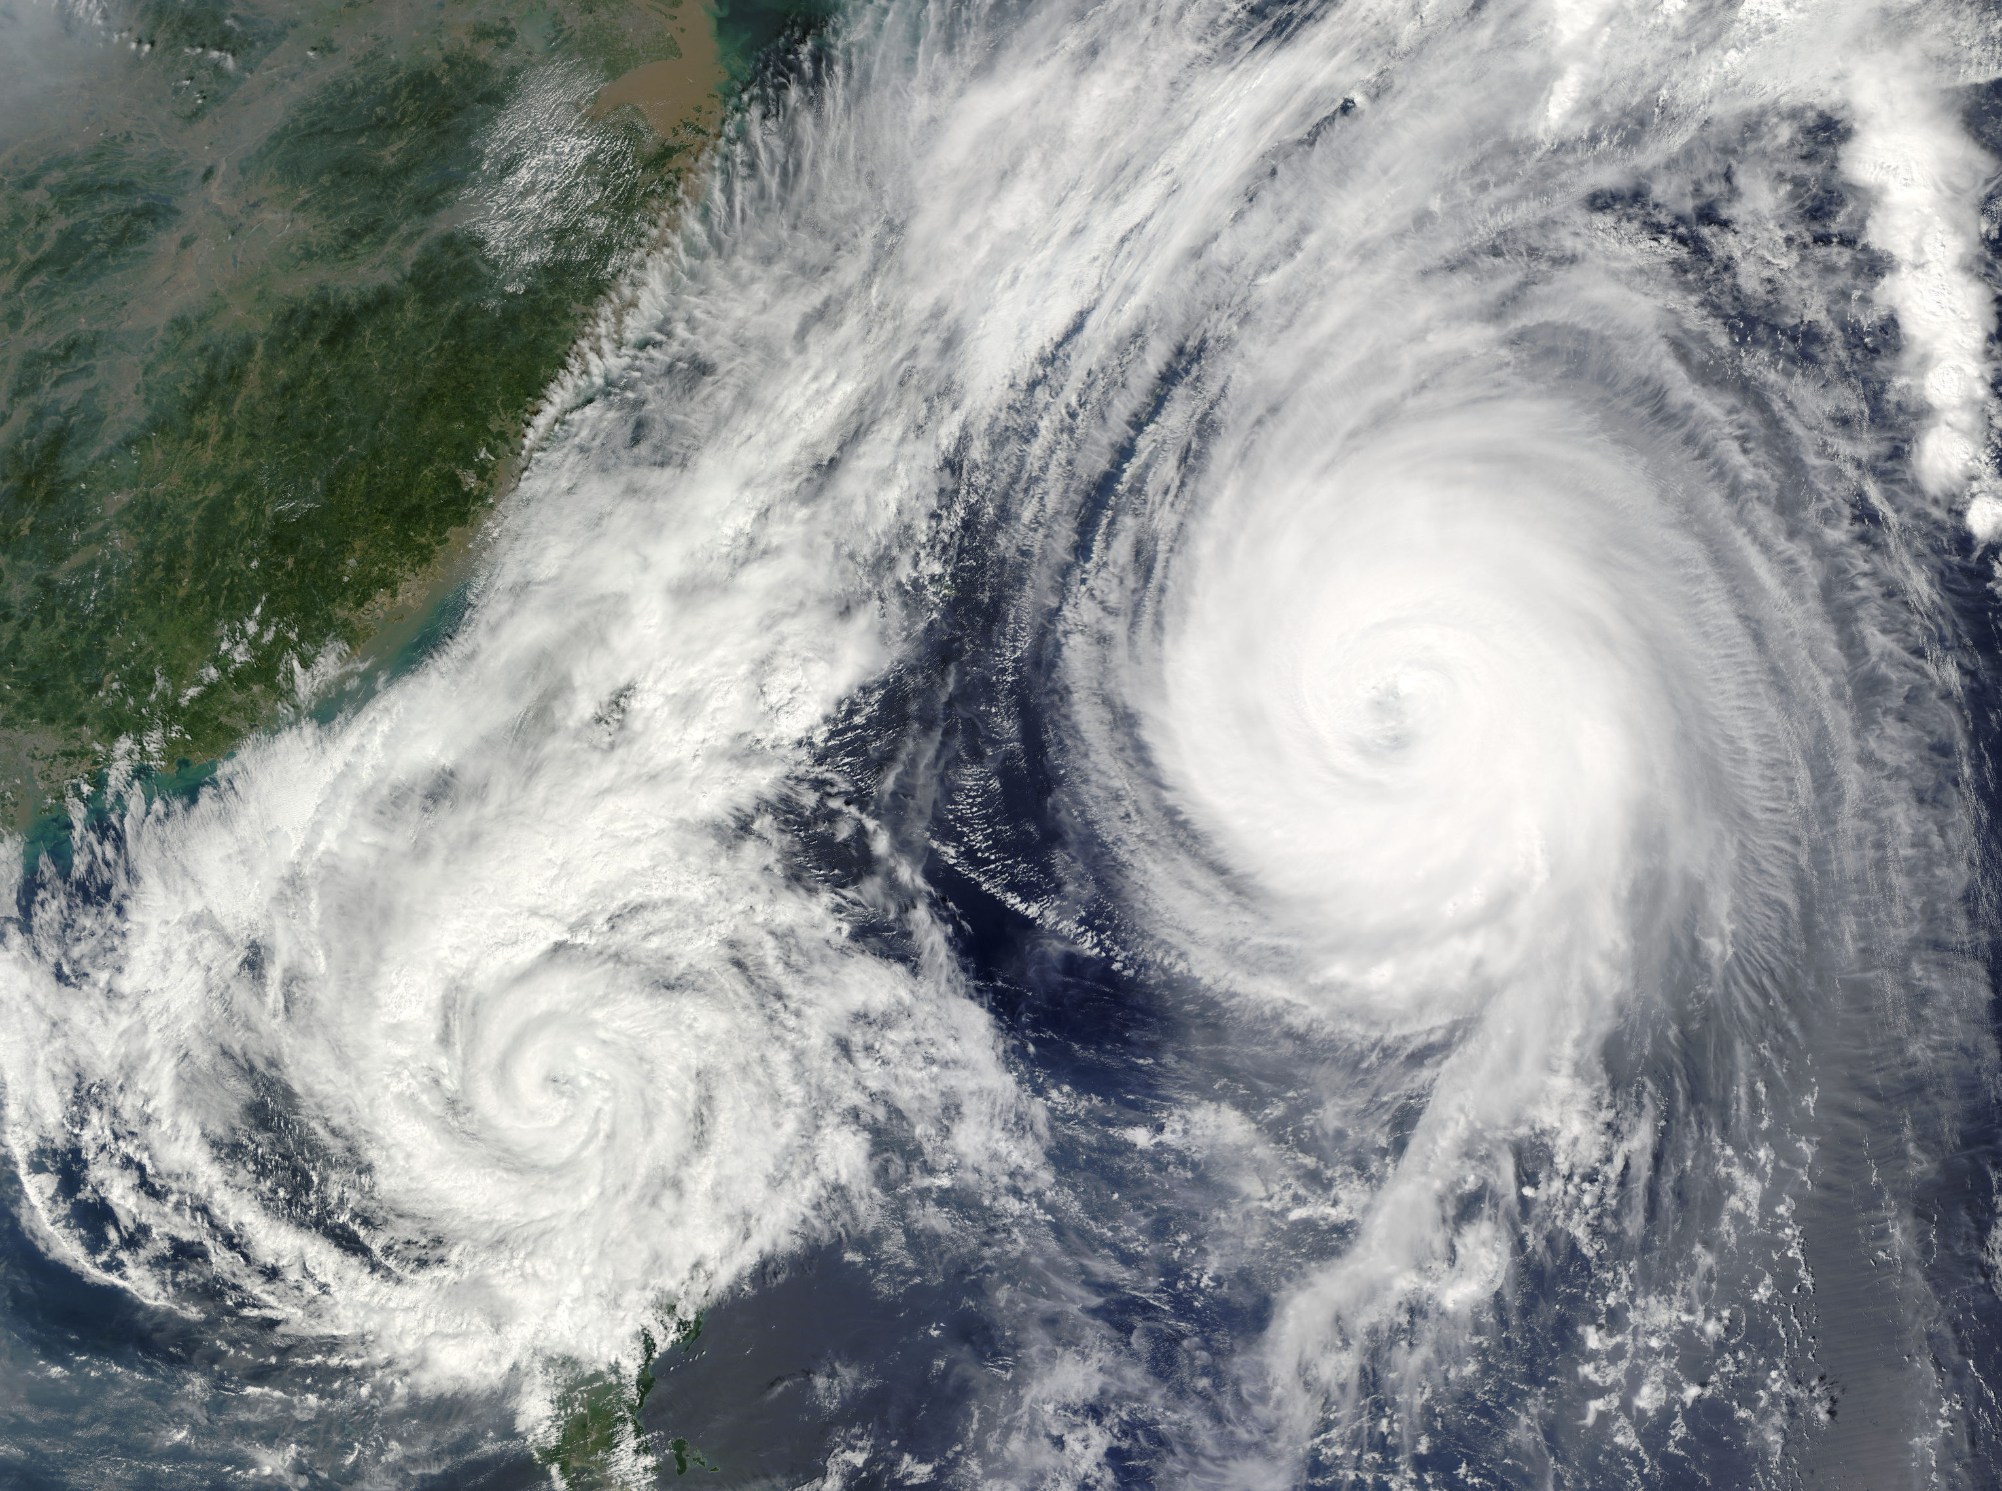

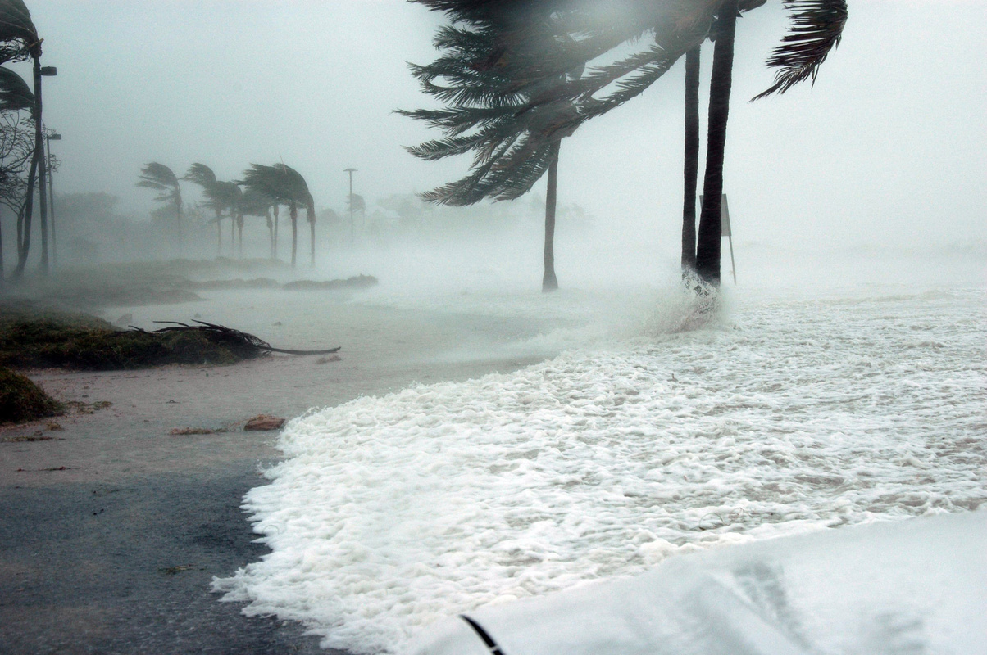

Research on Natural Disasters
Risk Control Organization- SafeHorizon
By Inês Bettencourt Macedo
SafeHorizon

Slide 2
Project overview
Risk Control Organization-
What is?
Study the locations
Improve infrastructure
Increase security and resilience
Reduce vulnerability
SafeHorizon

Slide 3

Project overview
Hipoteses
The prevalence of certain disaster types, such as floods, is significantly associated with specific geographical and climatic conditions, particularly in warm and dry zones
2. "The countries most frequently affected by natural disasters are not necessarily the same as those experiencing the highest severity of incidents, indicating a complex relationship between disaster occurrence and impact"

Slide 4
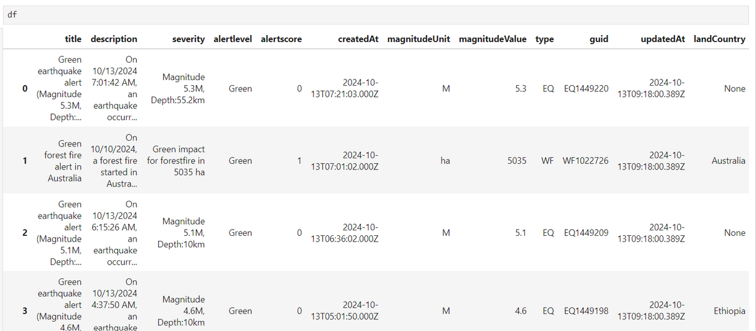
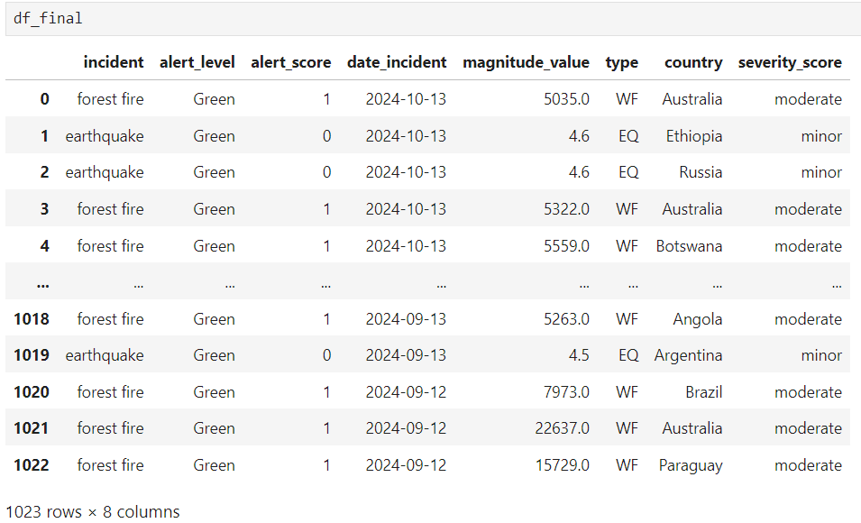
Project overview
The process of cleaning

Slide 5

Data Wrangling & Cleaning
Everytime we run the code for API request we get the latest information on incidents accross the world
.env file for my API_KEY to retrive the data
create DataFrame with the responses from 60 pages corresponding to occurences of the past month
Drop unnecessary columns
rename columns
Clean the NaN with .isna().sum()
standerdize the dates with regex
replace() functions to standerdize values
for loops to iterate over the desired data
save file as csv

Slide 6
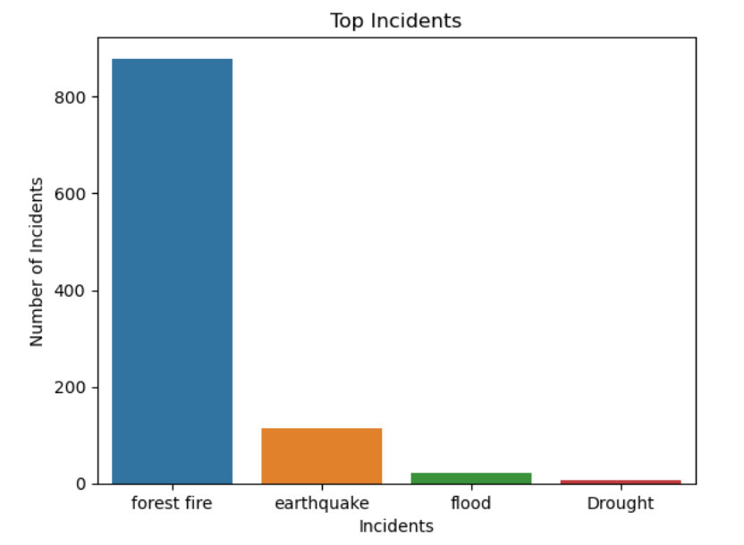

Exploratory Data Analysis

Slide 7
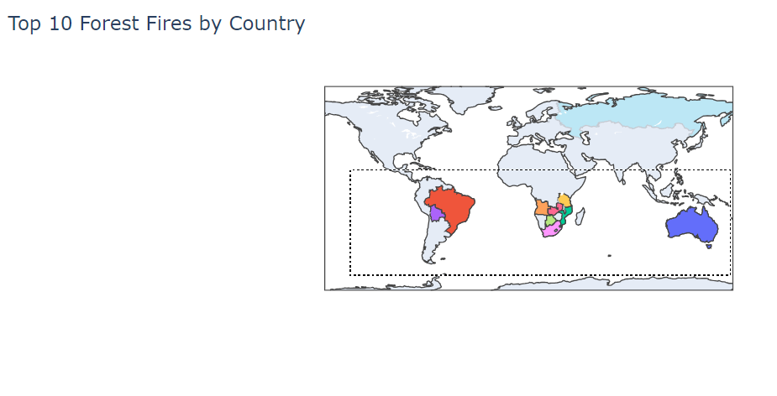
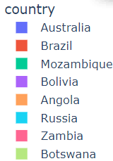
Hipoteses 1:

Slide 8

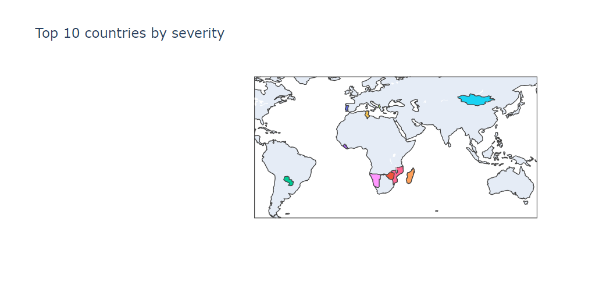
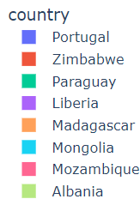

Hipoteses 2:
import plotly.express as px

Slide 9
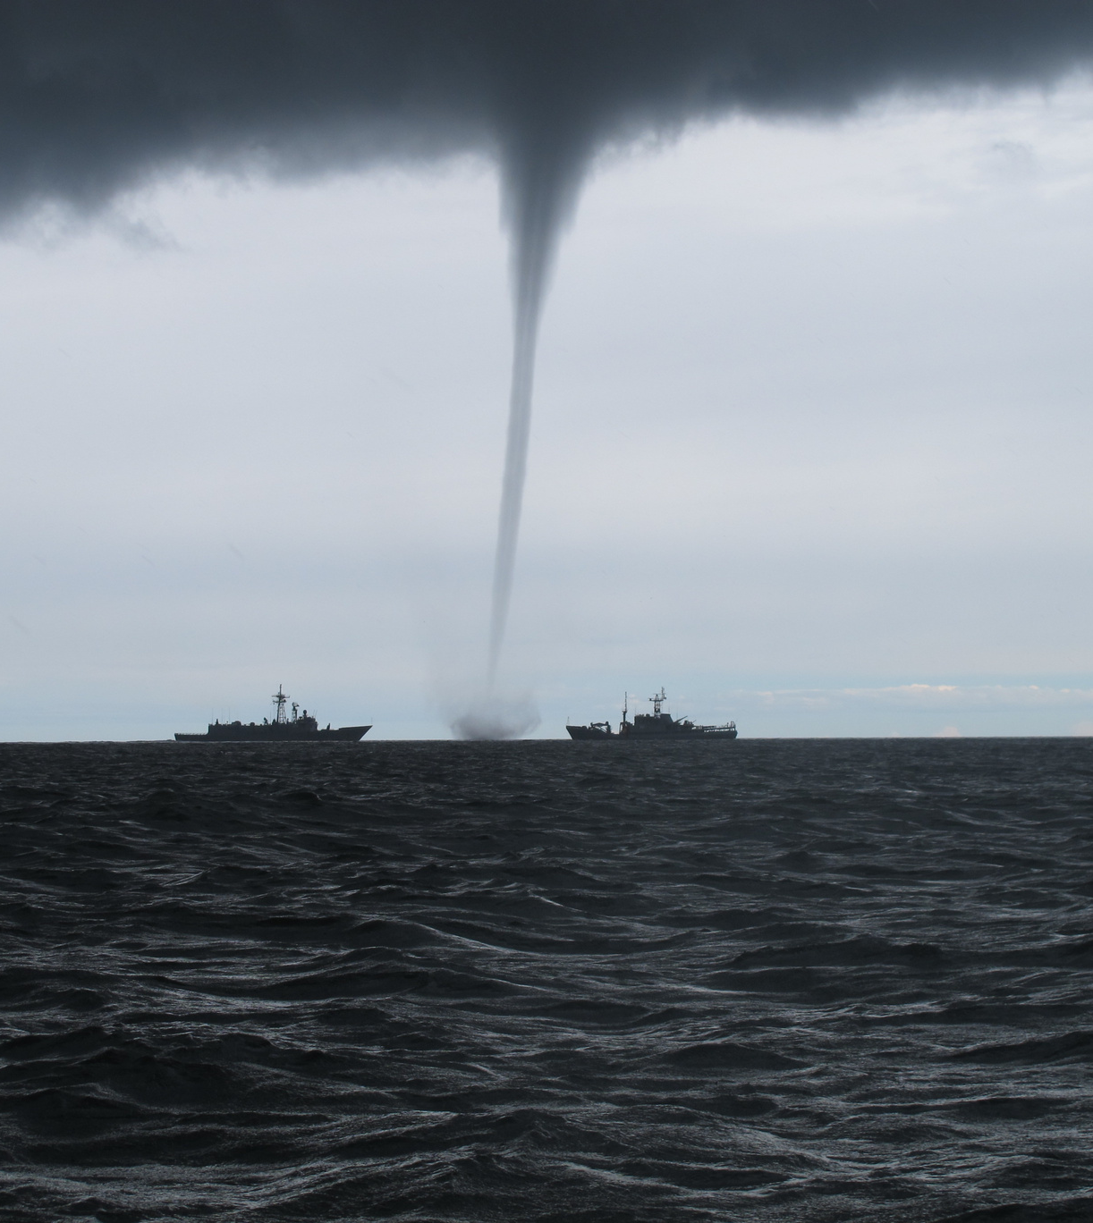
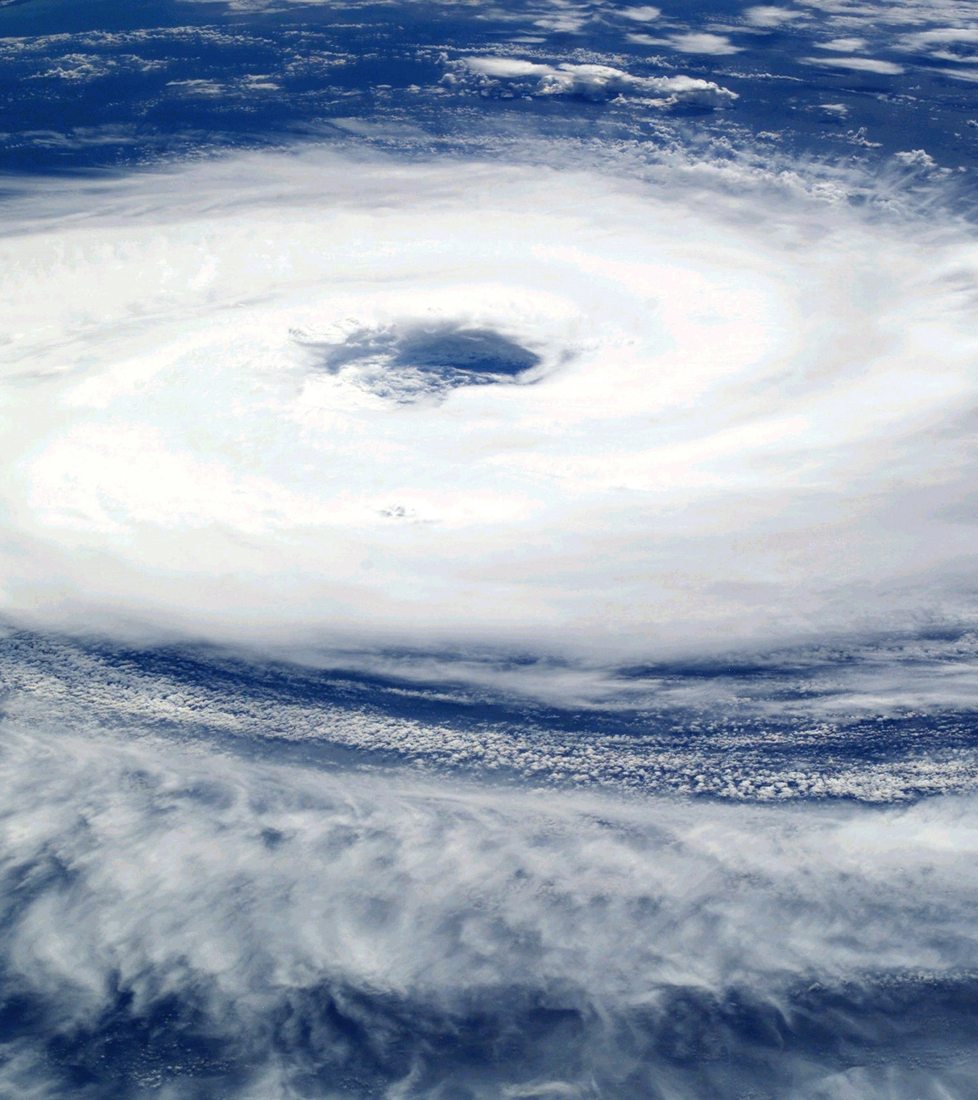

Major Obstacle
Multiple Pages of Data from my API

Slide 10
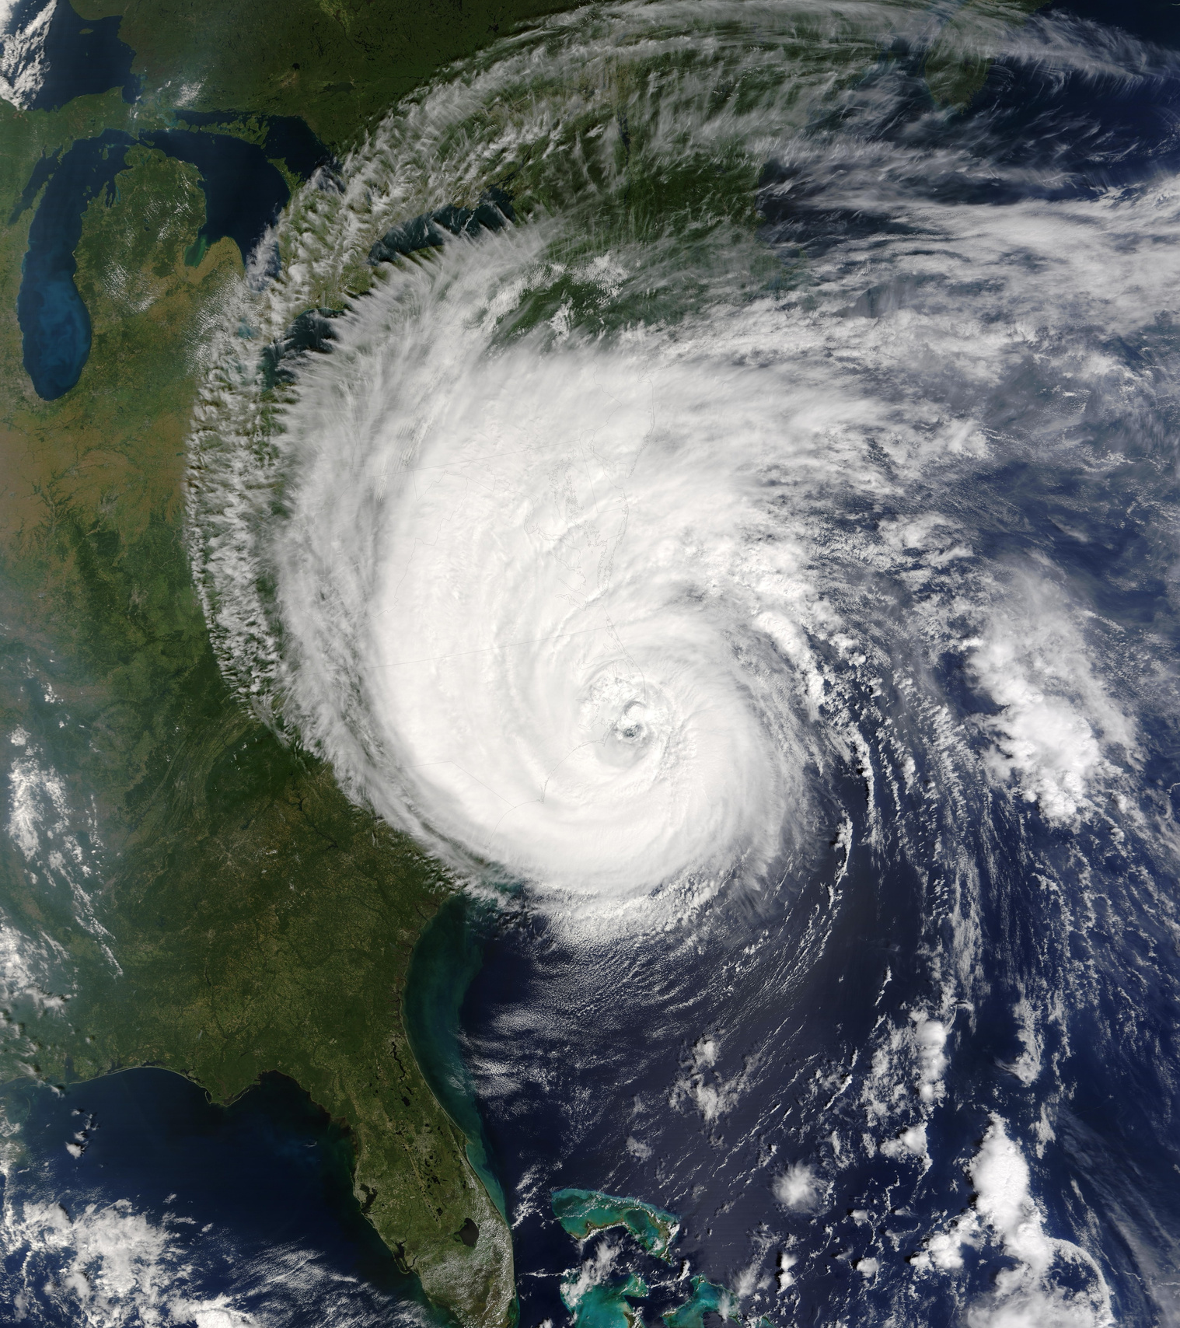


Conclusion
Psst!
For more detailed information check my GitHub account
https://github.com/InesBett/first_project?tab=readme-ov-file
Hypothesys

